Slide 1
College Majors: Best Salaries
K-Means Clustering
Notes:
The goal of the Project is to find the majors that have the best salaries. Should you do Engineering or Math or Economics or maybe Graphic Design? Choosing a college major is a big task. Students must choose a course of study that will challenge and fascinate them while balancing the harsh realities of the labor market and career prospects. A high starting income is essential for a stable middle-class future, and with rising student loan obligations, picking a major that pays well right away becomes even more appealing.

Slide 2
20%
30%
What are the highest paying fields?
What are you interested in?
Choosing a Major
30%
10%
What are your biggest priorities
What are you good at?
Notes:
While there’s a lot of factors you have to take into consideration when choosing a major, for a significant number of students. When considering which major to pursue, determine how important salary and salary potential weigh into your decision-making process. If you're motivated by high earnings, pursuing a degree in a STEM-related field may appeal to you.

Slide 3
GOAL OF THE PROJECT
The goal of the project is to find the majors that have the best salaries. Should you do Engineering or Math or Economics or maybe Graphic Design? Choosing a college major is a big task. Students must choose a course of study that will challenge and fascinate them while balancing the harsh realities of the labor market and career prospects. A high starting income is essential for a stable middle-class future, and with rising student loan obligations, picking a major that pays well right away becomes even more appealing.

Slide 4
Data Background
Career Percent Growth
Major
Starting Median Salary
Mid Career Salary
Percentile - 10,25,75
01
02
03
04
05

Slide 5
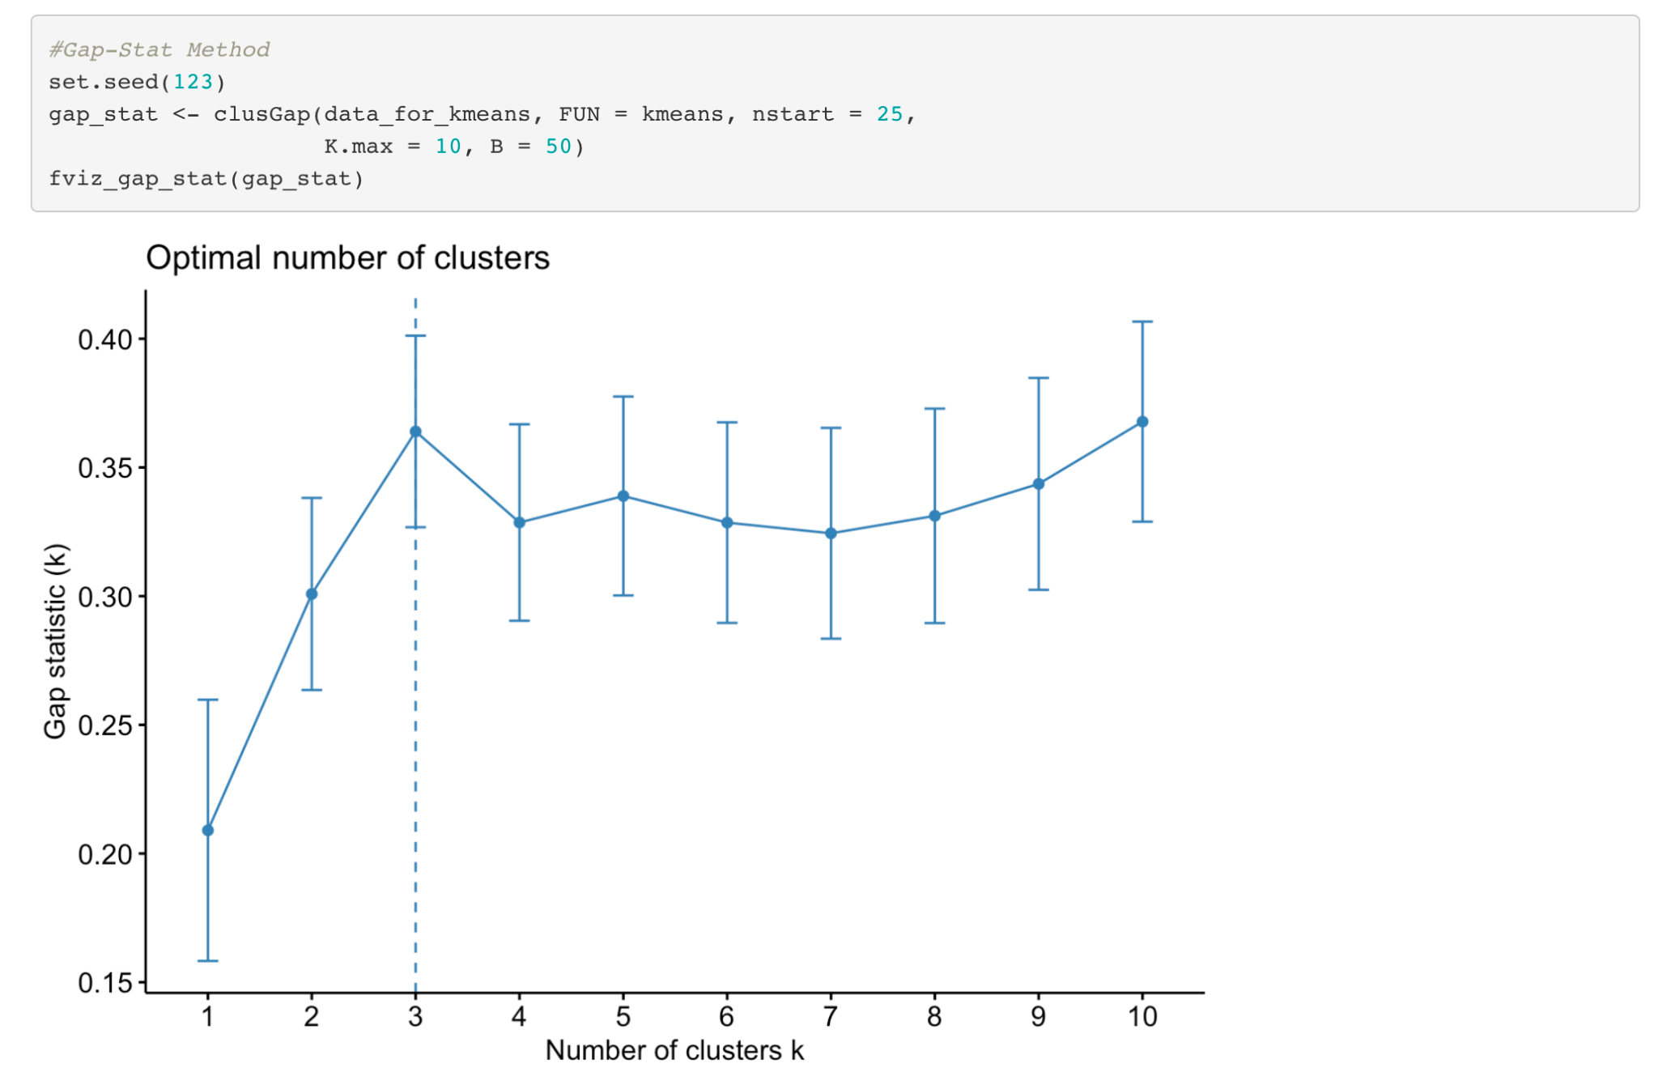
Data Background
Notes:
We used all the three methods: Elbow, Silhouette, and Gap-Stat to find the optimal number of cluster and we ended up getting 3 with all of them.

Slide 6
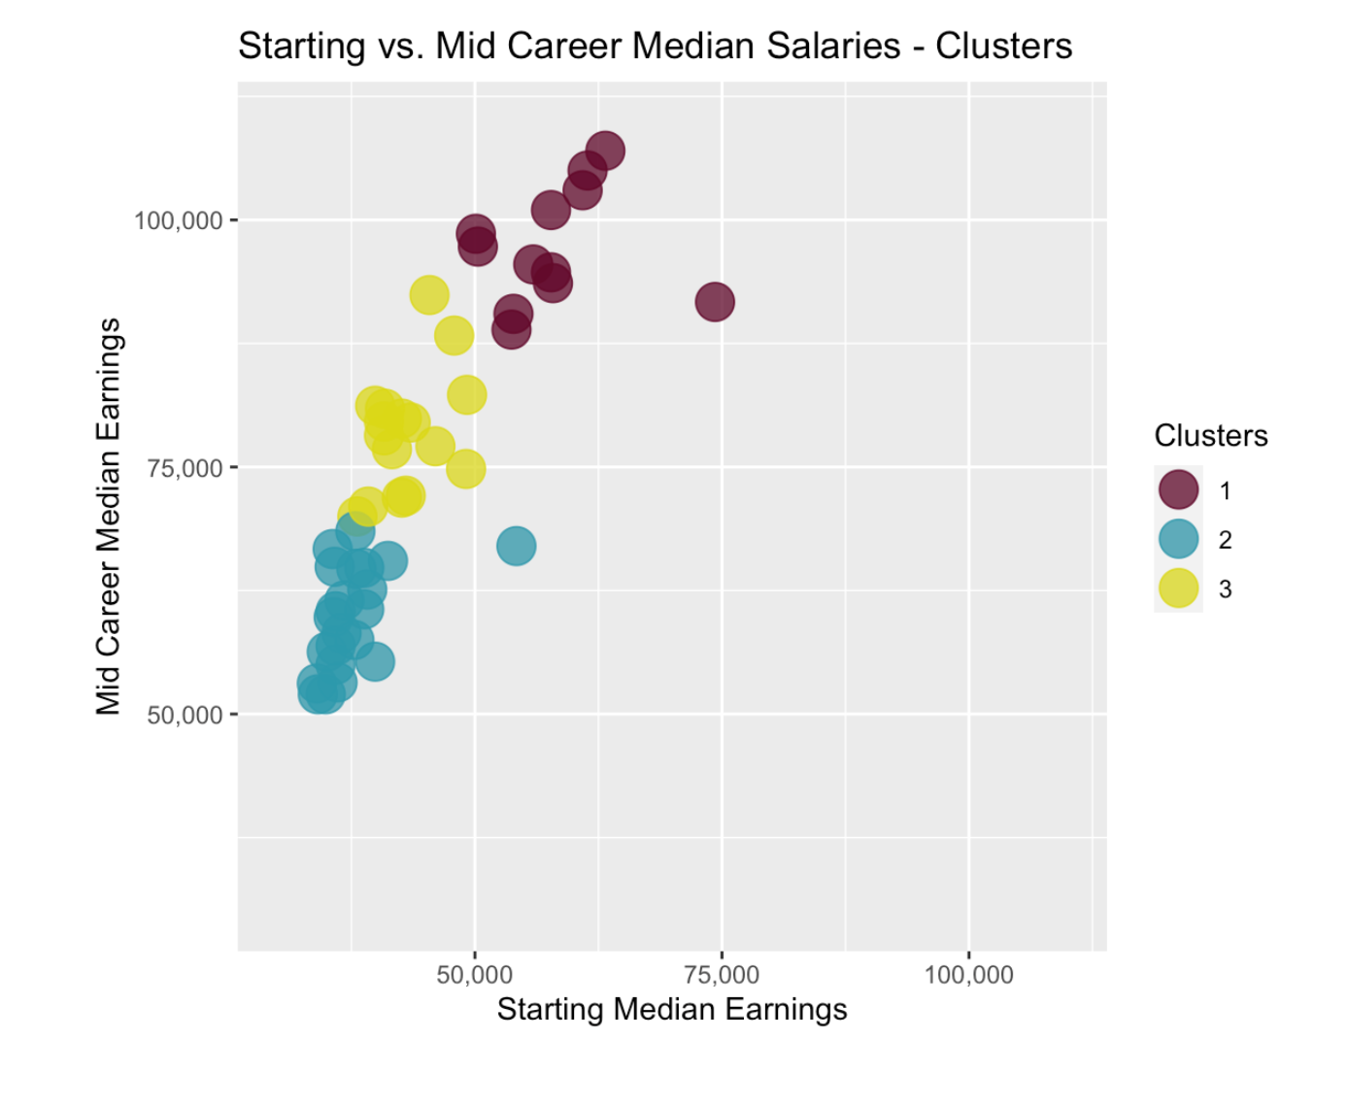
Starting vs Mid Career Median Salaries - Clusters
3 Questions for the Audience
 | What type of majors are in the brown cluster(cluster 1)?
 | What type of majors are in the yellow cluster(cluster 2)?
 | What type of majors are in the blue cluster(cluster3)?
Notes:
The majority of the data points are clustered in the upper left corner, with a reasonably linear connection. This means that your mid-career income will be higher if your starting income is higher. This is clearly supported by the three clusters, which give a degree of distinction. However, how may the clusters indicate mid-career development potential? We’ll need to restructure our data to see the wages of each college major and cluster sorted by mid-career percentiles in order to achieve this. We can examine the range of mid-career earning prospects for each cluster by graphing this.

Slide 7
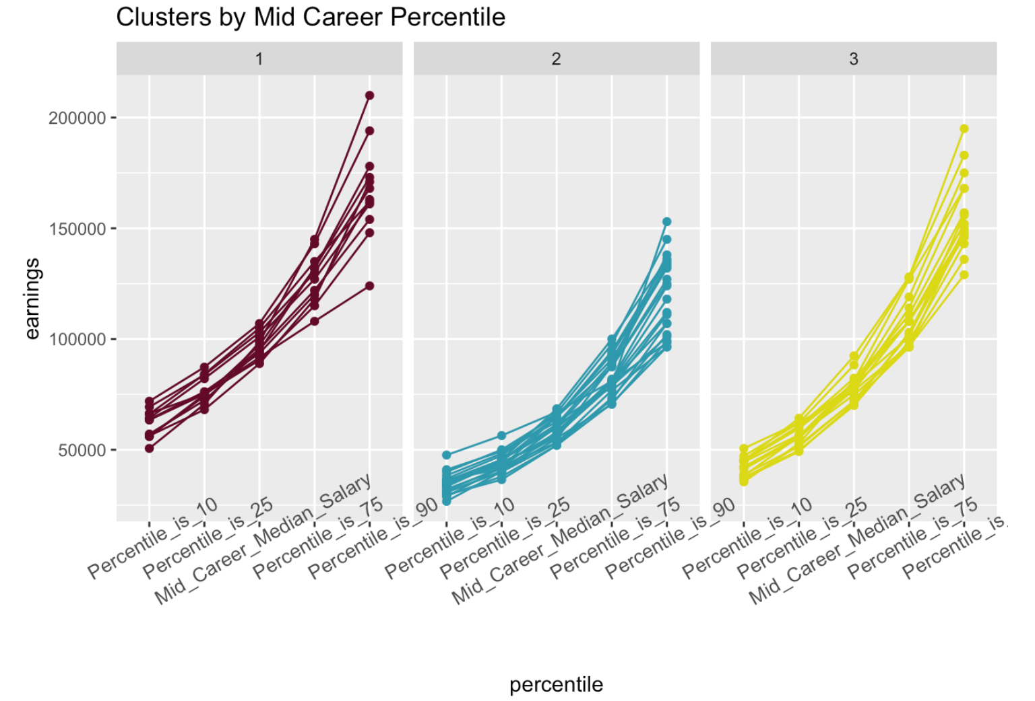
Clusters by Mid-Career Percentile

Slide 8
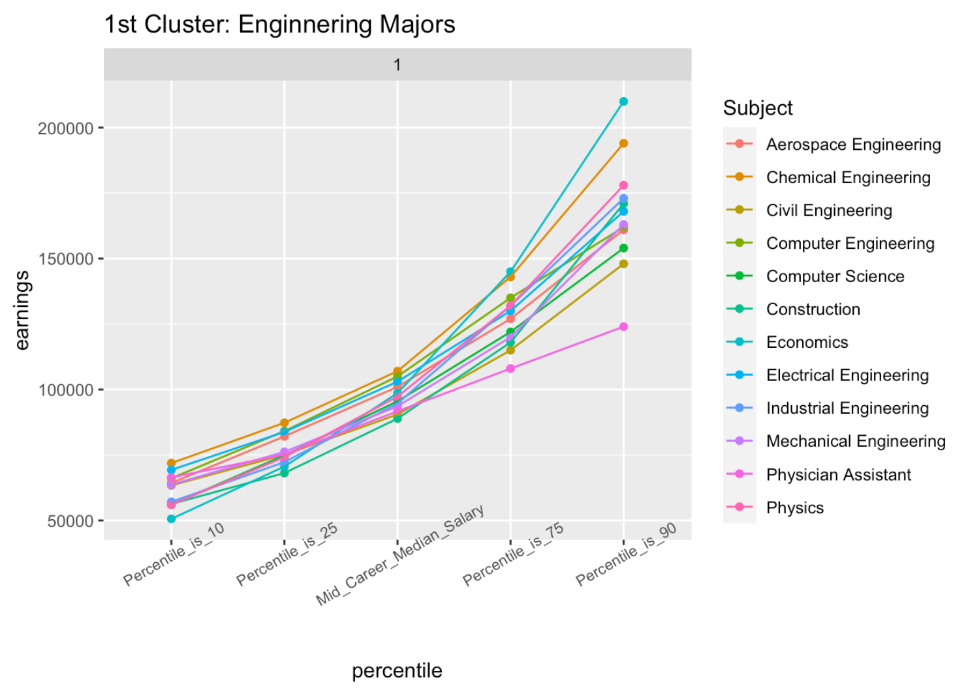
1st Cluster: Engineering Majors
Notes:
Engineering Majors: These are the majors to pick from if you seek financial stability. An engineering major may help you leverage your passion for math, physics, and building and constructing things into a successful job. Employers are continuously on the lookout for competent engineers, and the pay they give reflect how highly they value engineers. Engineers have the biggest potential for advancement in the 90th percentile and the best security in the 10th percentile.

Slide 9
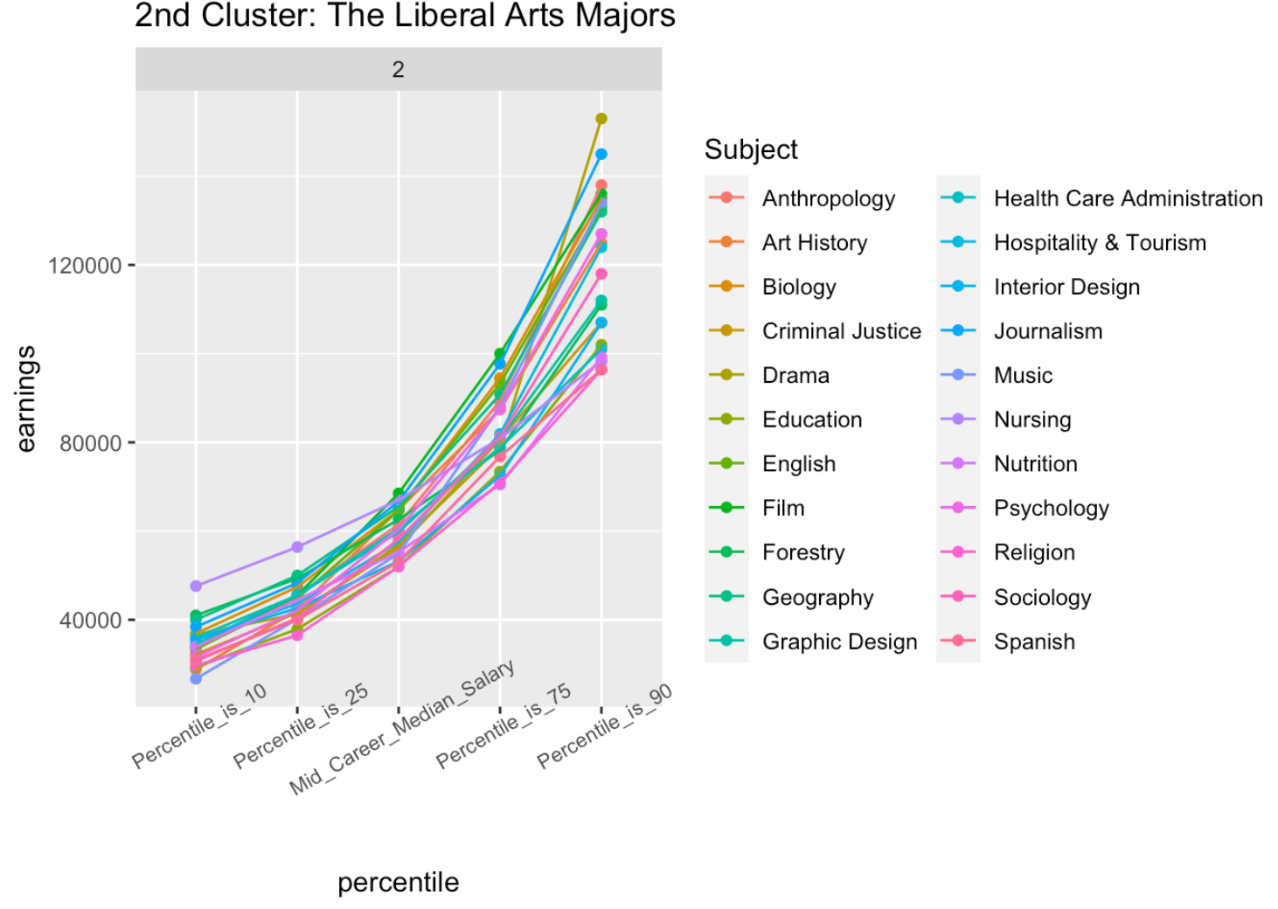
2nd Cluster: Liberal Arts Majors
Notes:
Liberal Arts Majors: These majors start off rough with low starting income but you can definitely make your way up if you work hard! The median income for these majors is very low as compared to the other two clusters. If we notice closely, if you do insanely well in Drama, you could be making as much as 150k a year whereas majors like Spanish or Religion have a very steep curve.

Slide 10
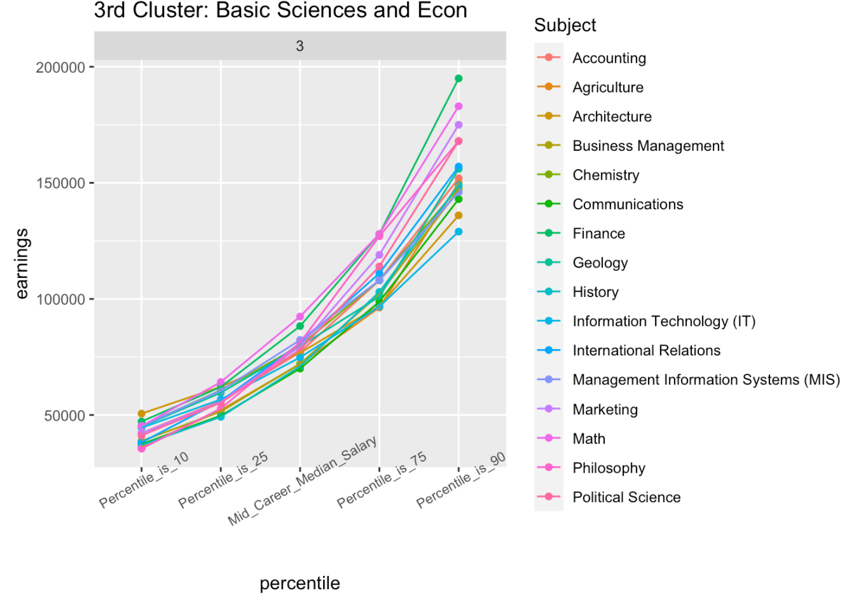
3rd Cluster: Basic Sciences and Econ
Notes:
Basic Sciences and Econ: These majors are known for having a good salary and job security. Subjects like Accounting & Finance, Communications do good in the higher percentiles and can help you become financially stable. The starting salaries for these majors isn’t very amazing but there’s enough room for growth if you keep working in these fields.

Slide 11
Conclusion
Engineering majors perform the best at 10 percentile, closely followed by Basic Math & Econ majors
The Liberal Art majors, as we saw, don’t have very impressive salaries but if you’re a good student you can definitely make your way up in the tables.
Engineering is your best shot at having your dream salary
01
02
03
Notes:
But again, it does come down to how you much effort you put into your academics and other factors like networking, school reputation etc.

Slide 12
Suryansh Chauhan, Cary Martin
THANKS
Do you have any questions?

